Slide 1
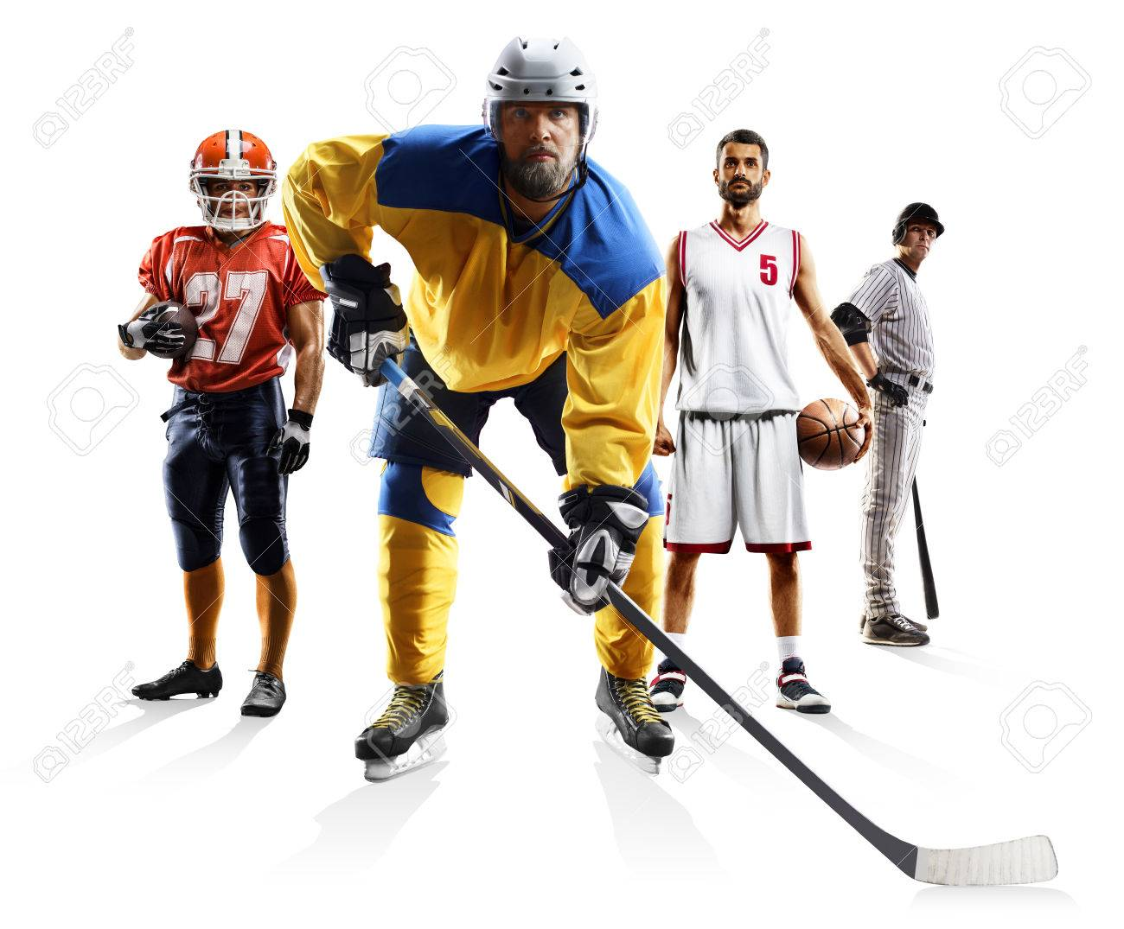
Predicting Professional Athlete Career Lifetime with Neural Network Modeling
Alyssa Allende Motz, Matthew DeYoung, Shihab Humayun, Peter Nielson

Slide 2




Overview
Our selected topic: we will predict the average career length of MLB, NBA, NFL, and NHL professional athletes based upon their position
We will implement a neural network learning model to predict career longevity of professional athletes based upon the position they play
The analysis will include data from 2004 to the present date
We will use aggregate career data from the National Hockey League as a basis for a neural network model which will predict career length

Slide 3
Motivation
Why we selected this topic: Professional sports are universally enjoyed by many, and in addition to being entertaining, there are several dimensions that are intriguing from the data science perspective.
Our results will be real-world applicable and have interest across disciplines, including sports recruiters, team managers, sports fans and athletes alike
There is a vast amount of easy to access, and accurate data available for NHL professionals
The combination of the topic and the data set available represent a case which is straightforward to represent in a Neural Network Model (NNM)

Slide 4
Premise
Questions we hope to answer: apart from the main topic, we anticipate our model may also provide insight into the following questions
Does the athlete’s age at the start of their career have an influence on career length?
Do the career lengths follow a statistical model (eg a bell curve)? Are the different positions similar or not in this sense?
Are there any interesting outlier data points? What does this add to the story?

Slide 5
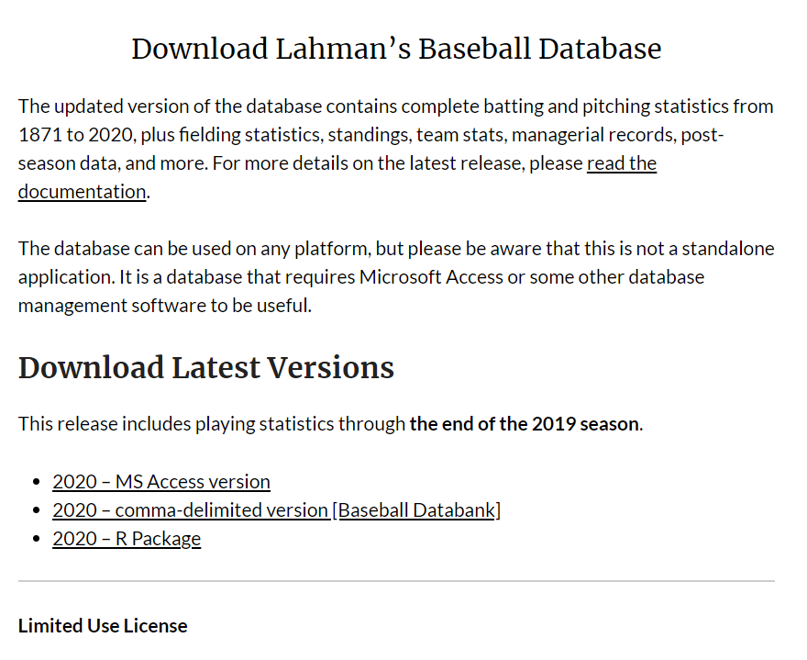
Source Data
Data Source MLB: Lahman’s data set contains complete batting and pitching statistics from 1871 to 2020, plus fielding statistics, standings, team stats, managerial records, post-season data, and more
http://www.seanlahman.com/baseball-archive/statistics/

Slide 6
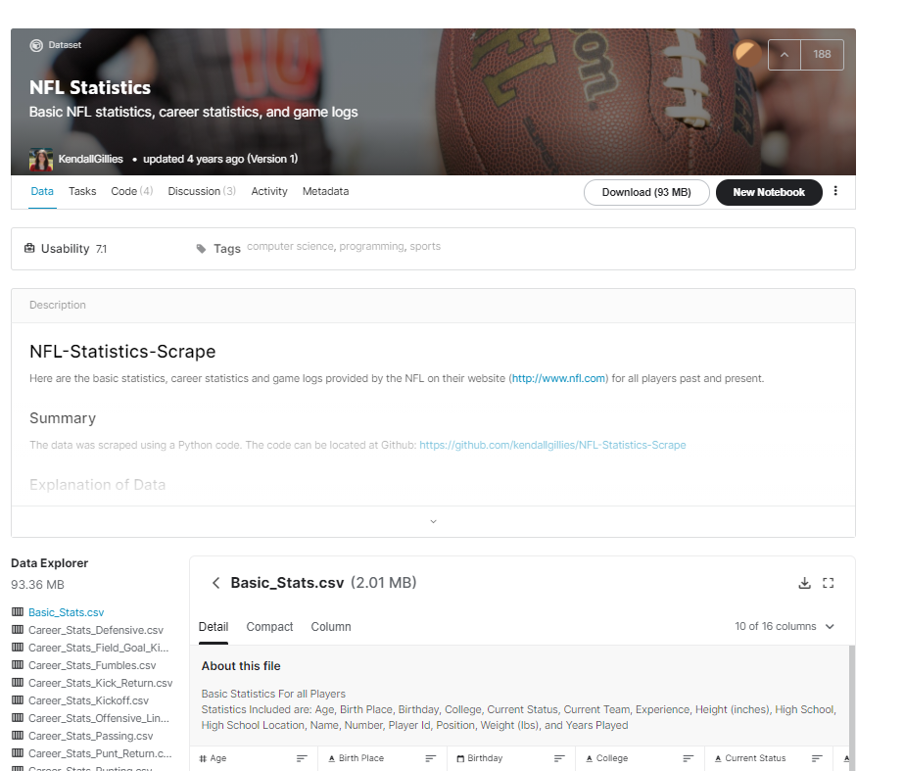
Source Data
Data Source NFL: The data-set contains career statistics of players past and up to 2017
https://www.kaggle.com/kendallgillies/nflstatistics

Slide 7
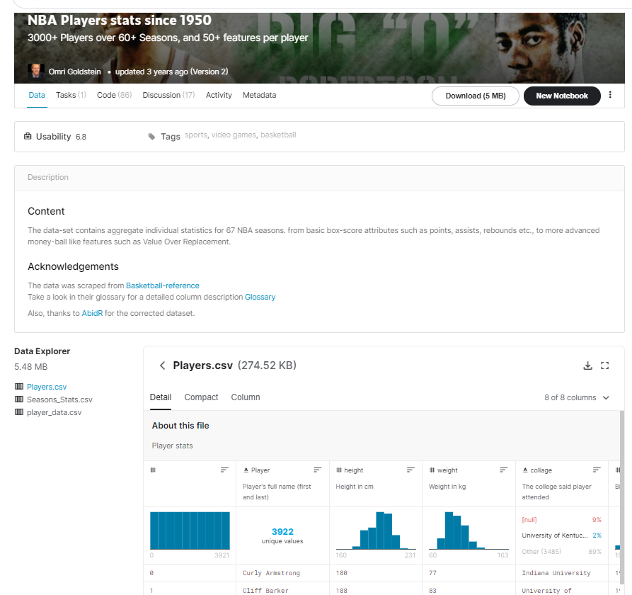
Source Data
Data Source NBA: The data-set contains aggregate individual statistics for 67 NBA seasons
https://www.kaggle.com/drgilermo/nba-players-stats

Slide 8
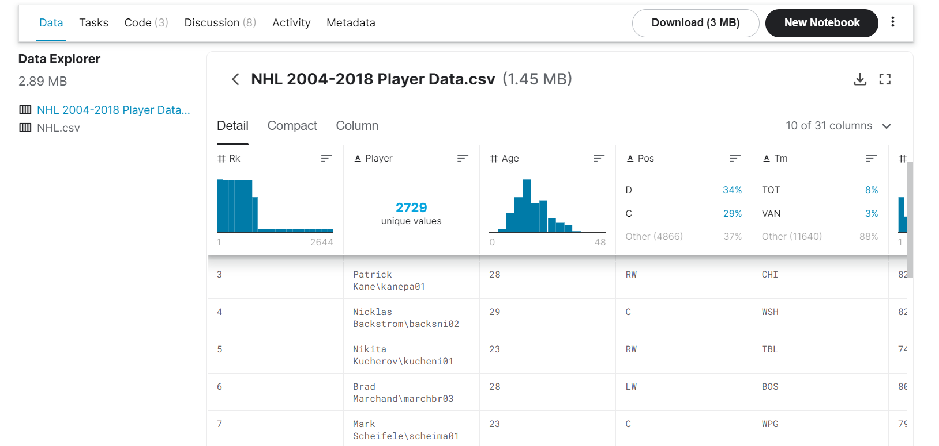
Source Data
Data Source NHL: This dataset comes from Kaggle, and summarizes statistics for all NHL skaters from the 2004 through the 2018 season
https://www.kaggle.com/xavya77/nhl04to18

Slide 9



Tools
Tools and technologies: we will use the following technologies
Python: implemented for cleaning of data, combining data sets into one and as well, running the NNM
SQL: implemented to hold database
Tableau: implemented for dashboard visualization

Slide 10
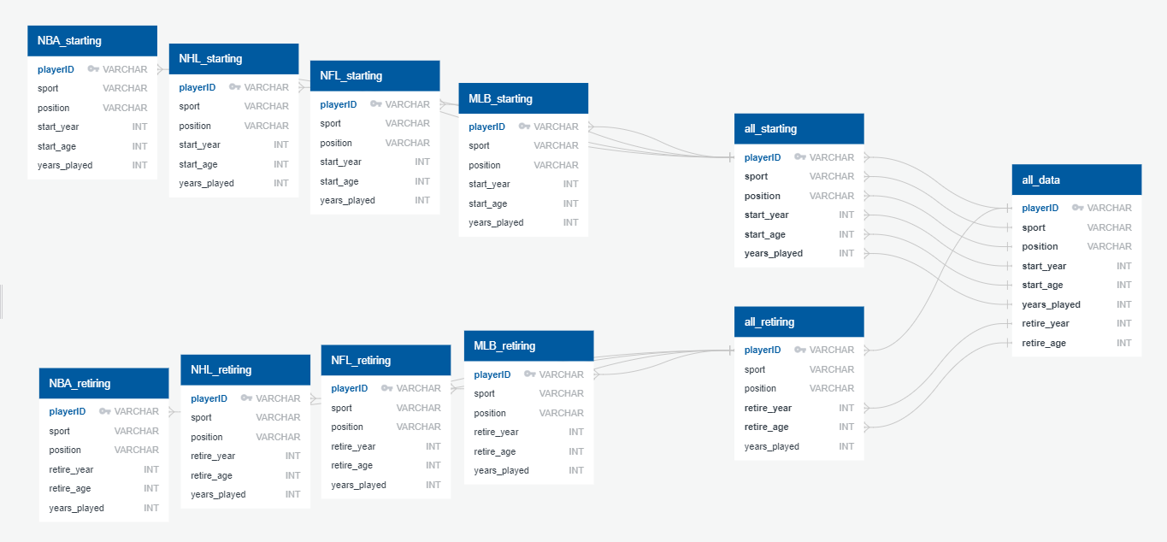
Source Data
Database:

Slide 11
Data Exploration
Summary: Our initial analysis of the data included answering the following questions
Initial import of data: what is the general structure (ie, how many columns and what is contained in each column)? How many players are included? Will there be enough data points to form a basis for machine learning?
Inspection of data: are there null entries, or duplicate entries, or any entries that should be removed for any reason?
Data visualization: are there any interesting outlier data points? Do they add to the story, or should they be removed?

Slide 12
Data Analysis
Summary: in order to prepare the data for our NNM, the following was performed
Remove players who played before 2004 and after 2018, and players with less than 2 years experience
Delete all but the necessary columns (Player name, age, position, season)
Reformat columns to desired output (Player, Posn, Start age, years played)
Drop retirement data

Slide 13
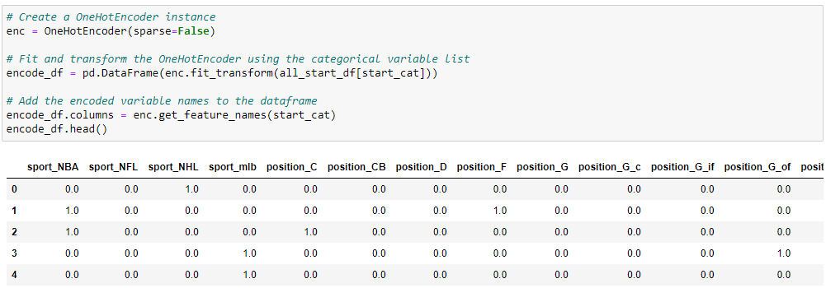
Neural Network Model
Summary: We used the One-Hot encoder because it allows the representation of categorical data, which is the positions of each sport to be more expressive. The neural network model cannot work with categorical data directly.

Slide 14
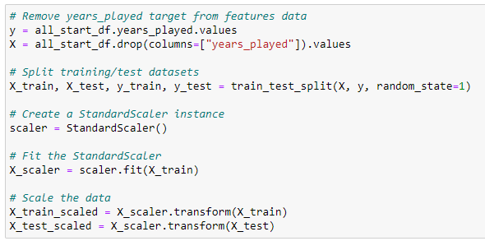
Neural Network Model
Summary: Our group will be implementing the neural network learning model in order to predict athletes career longevity from the NBA, NHL, NFL and MLB.
The independent variable for the first model will be when the player first started in the league. The y-value for the neural network model will be the years played of each athlete.
To increase the accuracy of the model, we must test and experiment with the loss and optimizers.

Slide 15
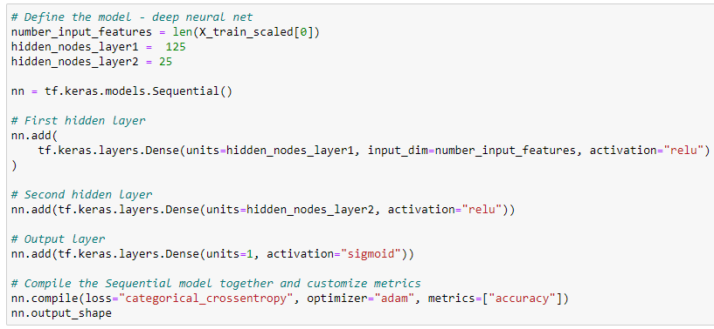
Neural Network Model
Layers:

Slide 16
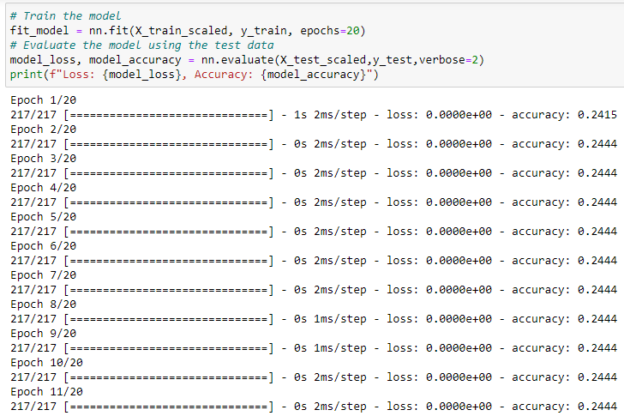
Neural Network Model
Summary: Training and accuracy
We will train the neural network learning model by using 75/25 proportion of the learning/testing data.
Model Accuracy Goal:
Our goal for this project to achieve a 60% accuracy on our neural network model.
Initial accuracy was 22% current: 24.44%

Slide 17
Story Board
Selected Platform: We will use tableau to design and present our dashboard
There is a vast amount of easy to access, and accurate data available for NHL professionals
The combination of the topic and the data set available represent a case which is straightforward to represent in a neural network model

Slide 18
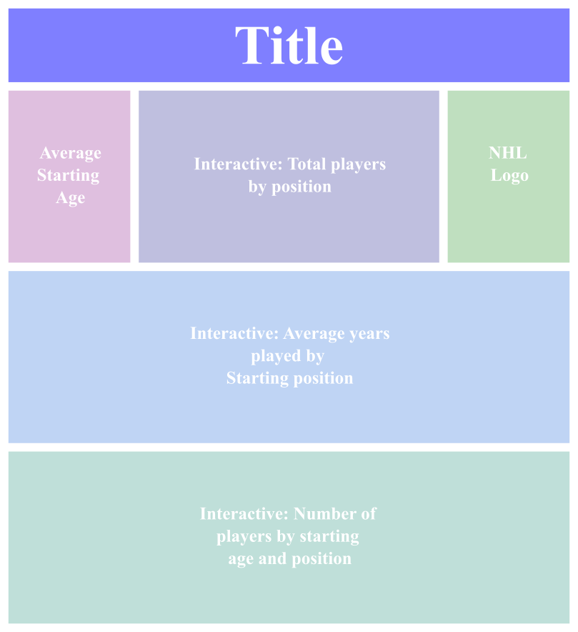
Story Board
Draft: We will use tableau to build our dashboard. A storyboard is shown below with a description of the elements
Title of project with brief description
NHL Logo for aesthetics
Average years played according to starting position, with interactive element (user can hover over graphs for a popup with more details)
Panel showing the average starting age of all positions
Total players by position, with interactive element (user selects position and graph updates accordingly)
Number of players by starting age, graph with interactive element (user can hover over graphs for a popup with more details)

Slide 19
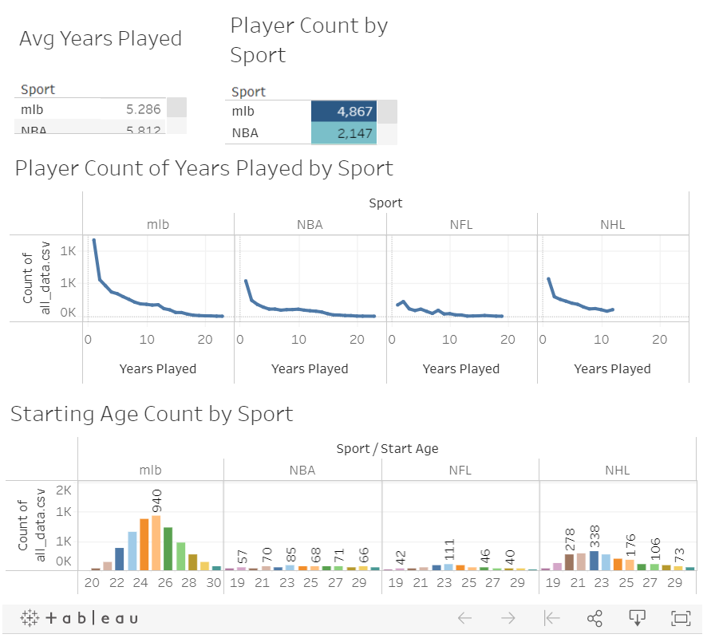
Dashboard
Current: the dashboard as it appears is shown in the image below
https://public.tableau.com/app/profile/matthew.deyoung/viz/SportsBreakdownDashboard/Dashboard1

Slide 20
Conclusion
Summary: did not achieve our goal, however experience was still very insightful. Most likely due to diversity of data sets and/or lack of uniform type of distribution between different data sets
Recommendations and Future Direction: We would recommend exploring different datasets, grouping by other types of independent variables, going more in depth with data cleaning, and trying different types of machine learning approaches

Slide 21
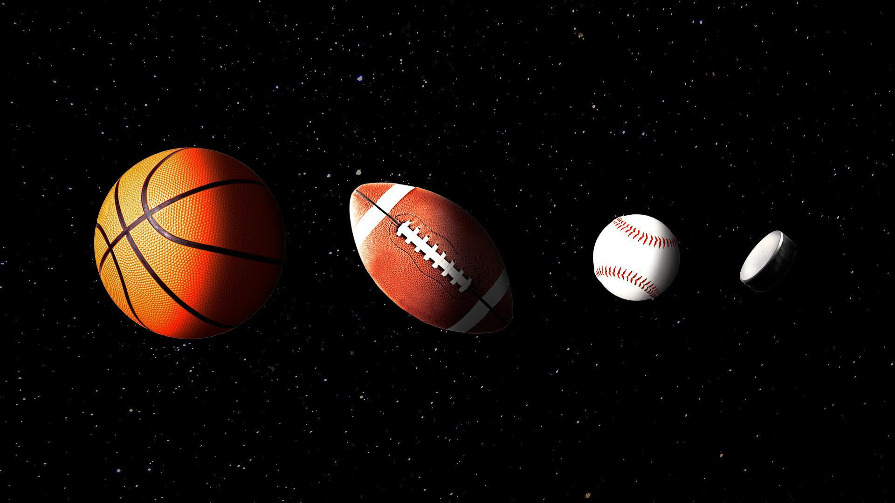
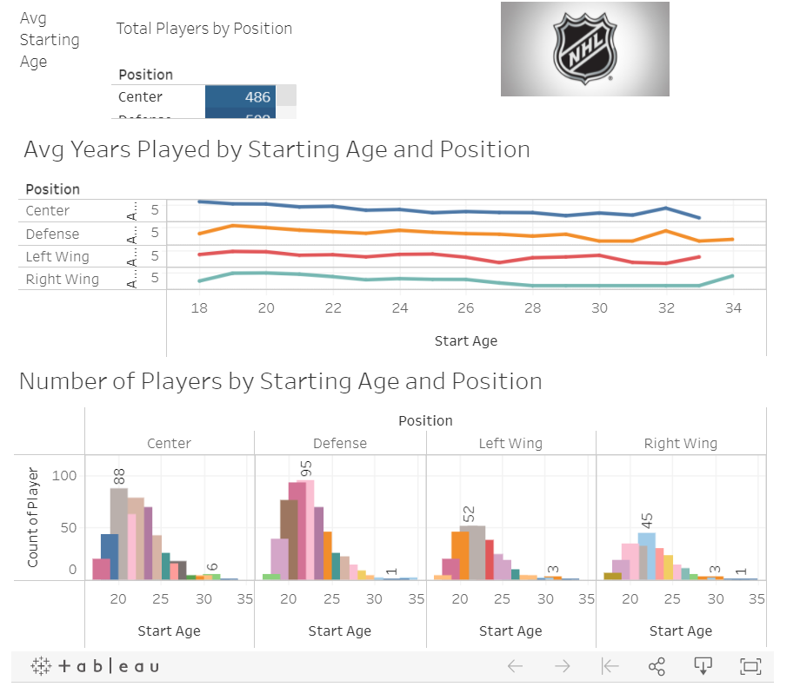
Dashboard
Questions?
Current Draft: the initial dashboard as it appears is shown below
https://public.tableau.com/app/profile/matthew.deyoung/viz/NHLDashboard_16266142750160/Dashboard1?publish=yes

